Slide 1
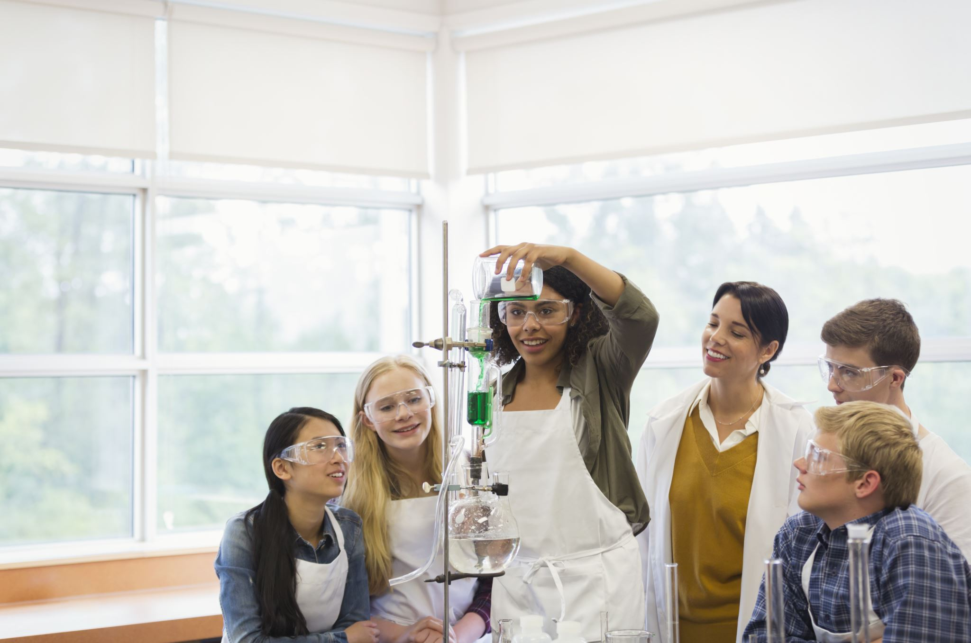
“Despite putting considerable effort into creating content and assessment, the students were not retaining the material, and at the end of the semester had a very poor grasp of fundamental concepts that were critical to advancement in their chosen careers...”
“…I needed a new approach, so I reflected upon the ways that I learnt about concepts with which I was unfamiliar, but more importantly, how I came to understand those concepts, and not just memorize them…”
Photo by Andrea Piacquadio from Pexels
Photo by Rahul Pandit from Pexels
Patch 17:
We have to
go deeper
Joanna Hodge and Laura Gibson, Fleming College
“…This was what I wanted for my students – comprehension, the ability to observe, describe and connect concepts and processes – deep learning.”

