Slide 1
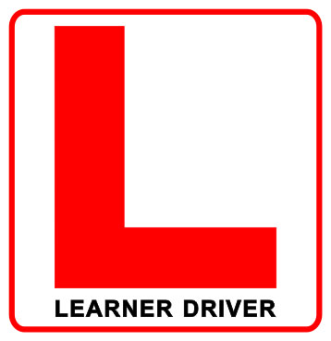
Metaphor – Who’s Driving As You’re Cruising Through This Course?
This Photo by Unknown Author is licensed under CC BY-NC-ND
Inspired by like Driving a Car exercise
Providing quality course resources
Creating a clear road map for success
Opportunities to practice
Gently guiding and correcting along the way
Testing understanding and application of knowledge
Passing the course
Now you are “licenced to keep learning and practicing”
This Photo by Unknown Author is licensed under CC BY-NC-ND

