Slide 1
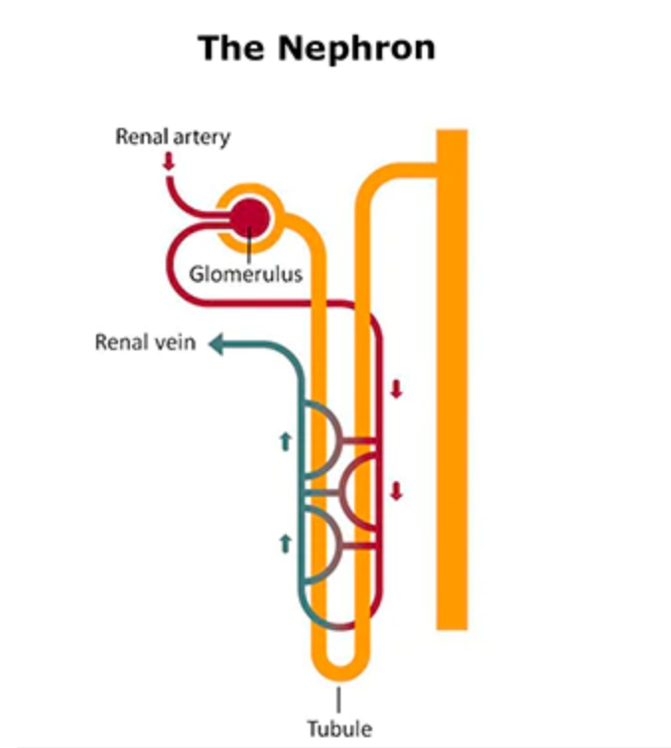
National Institute of Diabetes and Digestive and Kidney Diseases (NIDDK) 2021 Your Kidneys and How they Work. Retreived October 2, 2021 from https://www.niddk.nih.gov/health-information/kidney-disease/kidneys-how-they-work

