Slide 1
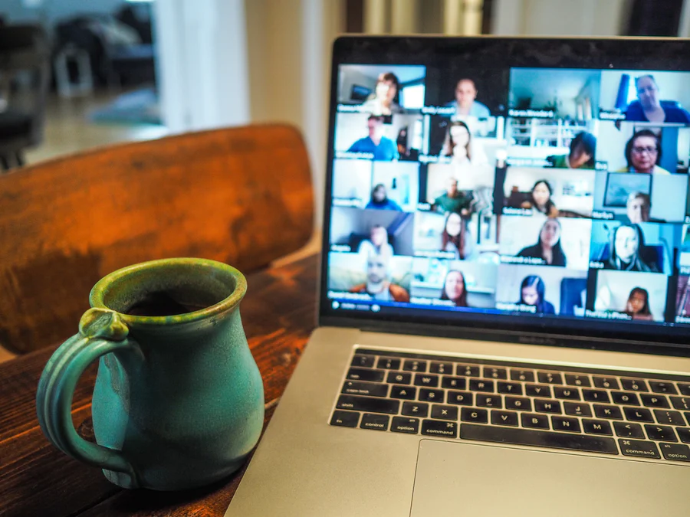
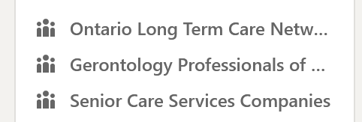
Sunnyside Foundation Board
Teams
Learning and development Conestoga College
Student Success Services
Techtutor@conestoga
Photo by Chris Montgomery on Unsplash

