Slide 1
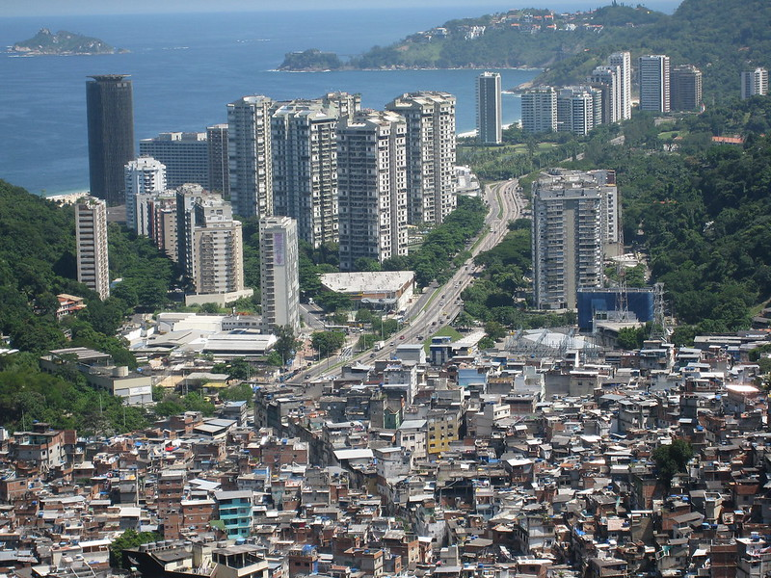
"Rocinha Favela" by AHLN is licensed under CC BY 2.0.
Notes:
"Rocinha Favela" by AHLN is licensed under CC BY 2.0.
I am teaching International Market entry and Distribution, and one topic that students got confused was to explain the misconceptions about the “bottom of the pyramid”. I give some examples that “the poor has money” and is a good market and ask them to explain providing examples. Some of the students’ answers are disconnected to the topic, talking about corruption or simply answering that the BOP can’t buy luxury items. The focus is to show them that the BOP can buy items above the basic needs, for entertainment or personal satisfaction.
I believe that the “Favela” image shows the contrast between the poor and rich, as well as that the poor can have more than the basic needs

