Slide 1
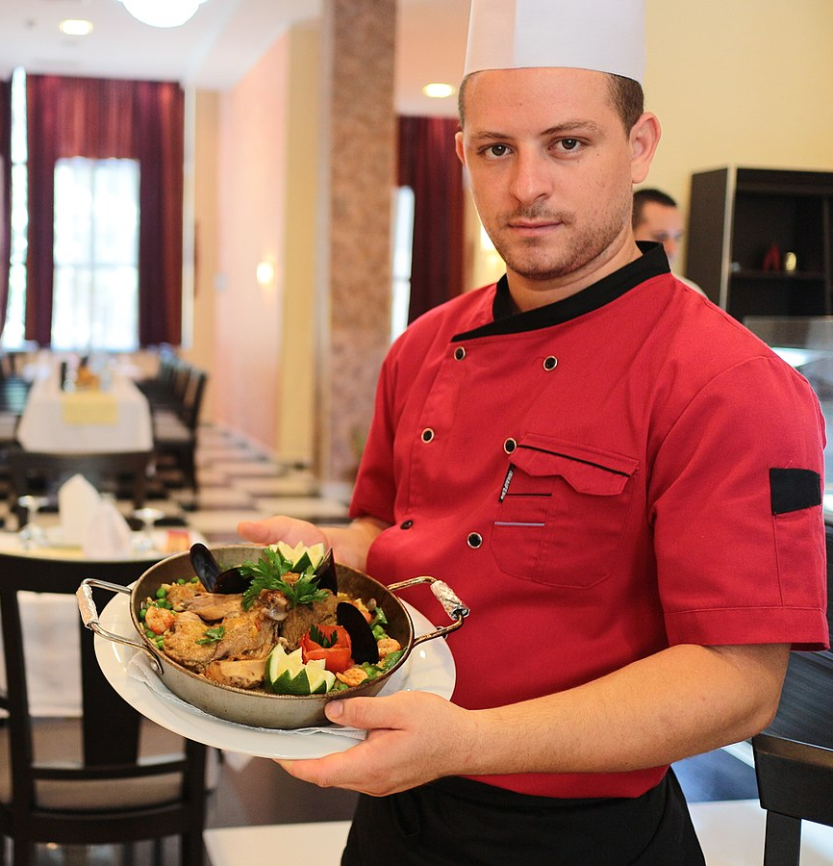
Being a teacher is being a chef of learning!
For each lesson, teachers do the following:
Choose the best learning for students according to their dispositions
Select the best ingredients of learning to make the best experience
Put together a recipe that introduces the ingredients in the proper order
Goes through the process and cooking to mix the ingredients together in learning
Serves out the overall learning experience
Enjoys when students succeed and devour the learning
File:Chef cuisinier.jpg. (2022, June 26). Wikimedia Commons. Retrieved 15:10, June 26, 2023 from https://commons.wikimedia.org/w/index.php?title=File:Chef_cuisinier.jpg&oldid=668536721.

